Slide 1
Disease Model
By
Ashish Bachuwar

Slide 2
Content
Business Aspects
ER Diagram (OLTP Disease Model)
OLTP Data Dictionary
Create & Insert – OLTP Model
Operational Queries – OLTP Model
DML Operations – OLTP Model
Dimensional Model (Star Schema)
Create Tables – Star Schema
ELT Process to Load Data
Analytical Queries – Star Schema Model
Visualization using Power BI
NoSQL Databases
AWS Architecture
Advantages of Snowflake

Slide 3
Business Aspects
Business Problem:
The aim is to identify the most common diseases and associated symptoms using the disease model.
Stakeholders Value:
Healthcare organizations and policymakers to prioritize public health initiatives
Allocate resources efficiently, and plan for future healthcare needs.
Pharmaceutical companies for drug discovery and development.

Slide 4
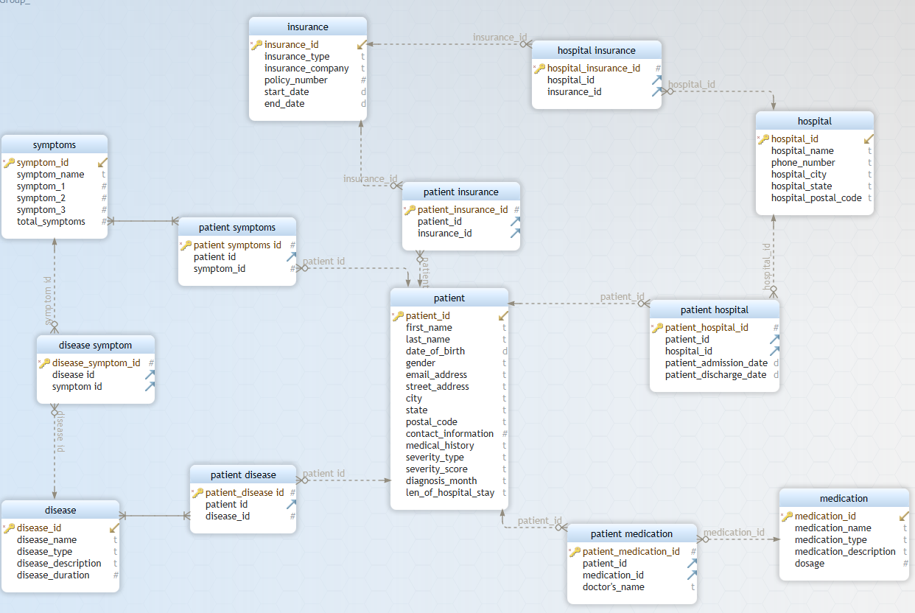
ER Diagram (OLTP Disease Model)
The ER diagram has 13 entities

Slide 5
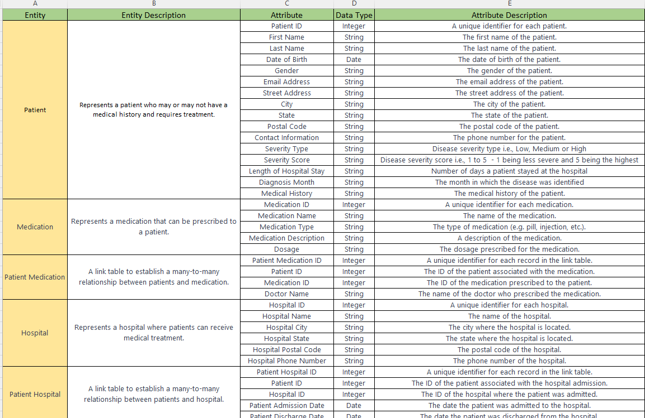
OLTP Data Dictionary

Slide 6
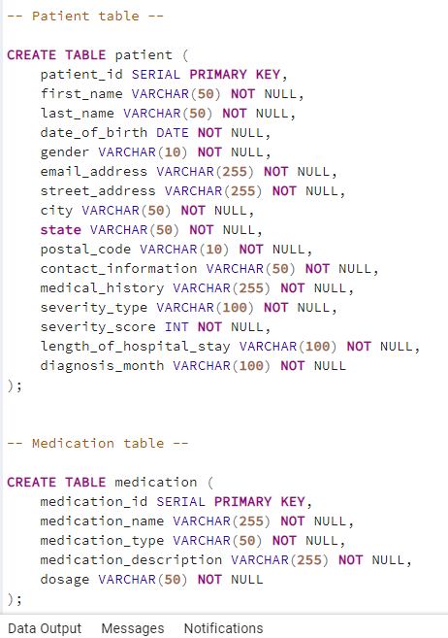
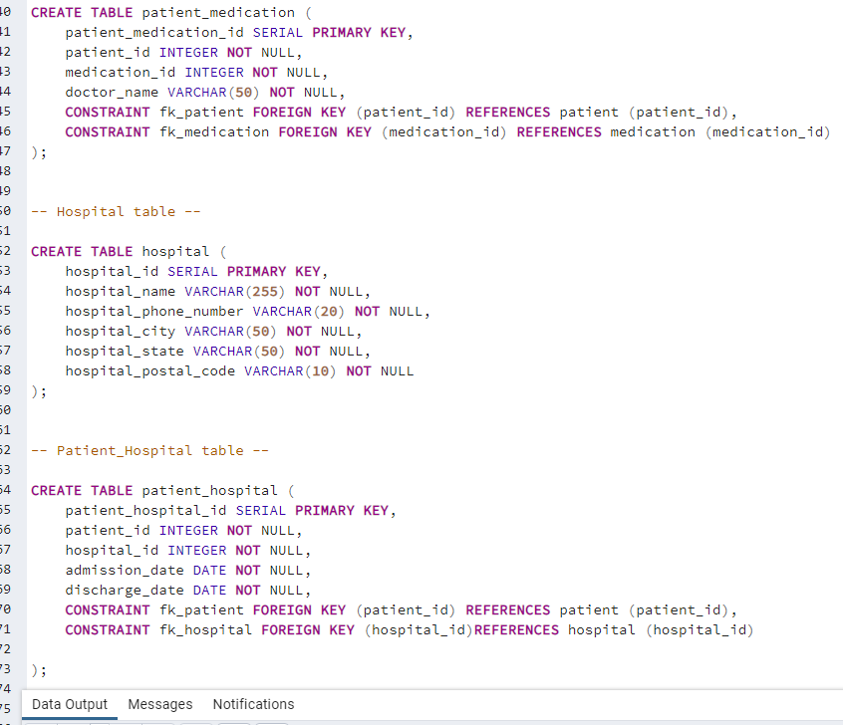
Create Tables – OLTP Model

Slide 7
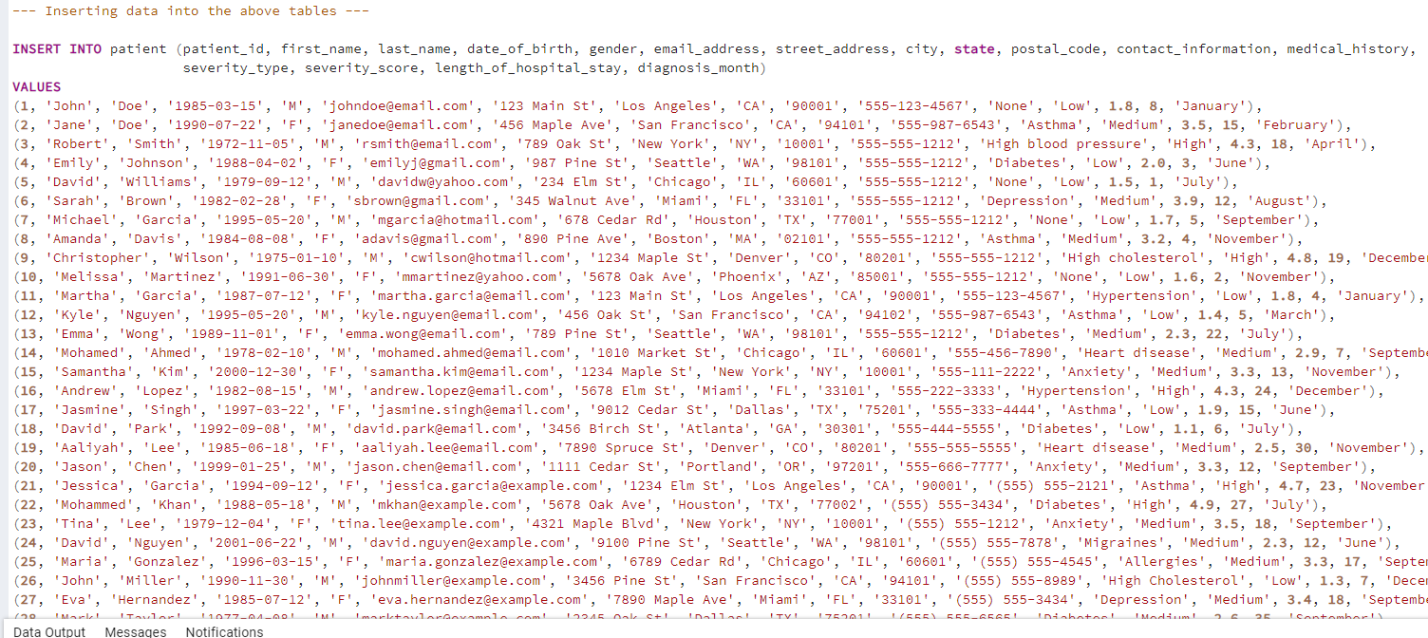
Inserting Data – OLTP Model
Data Source: Dataset - Catalog

Slide 8
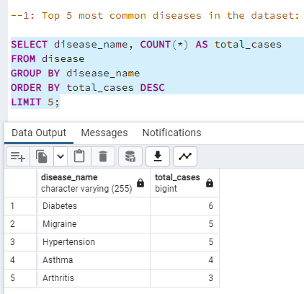
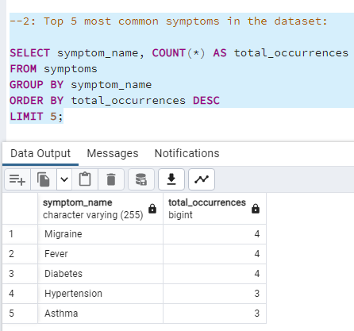
Operational Queries – OLTP Model

Slide 9
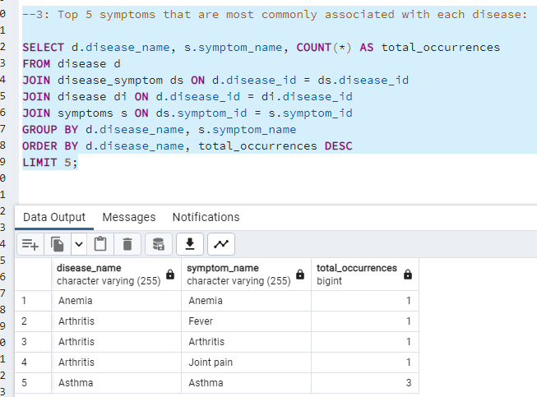
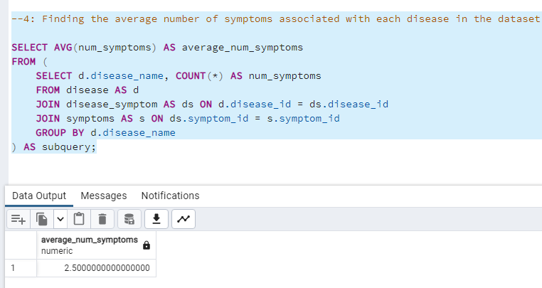
Operational Queries – OLTP Model

Slide 10
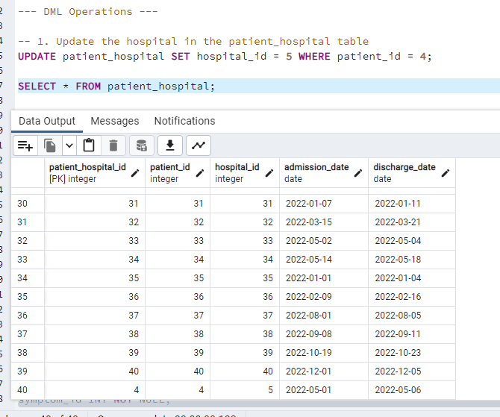
DML Operations – OLTP Model
The last row showing the updated hospital ID

Slide 11
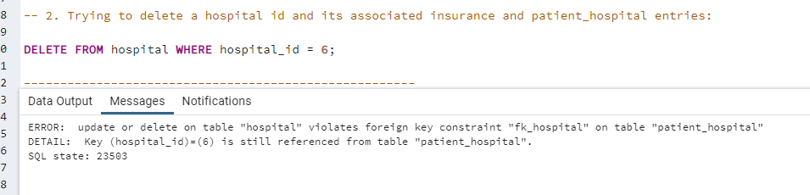
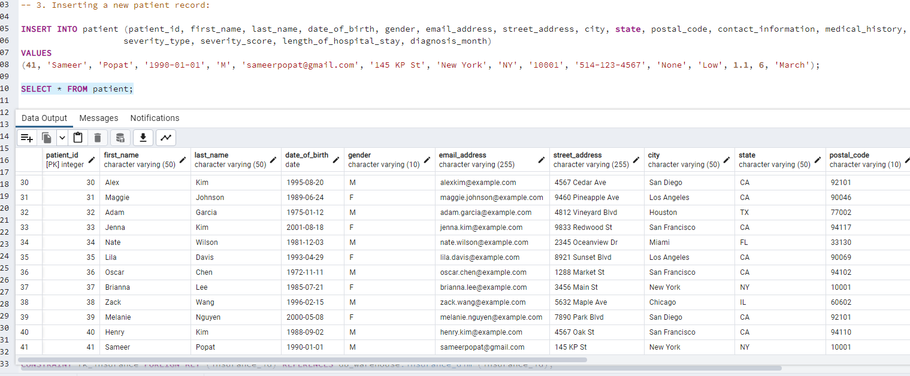
DML Operations – OLTP Model
Due to referential integrity, the delete DML operation doesn’t work
A new record has been inserted

Slide 12
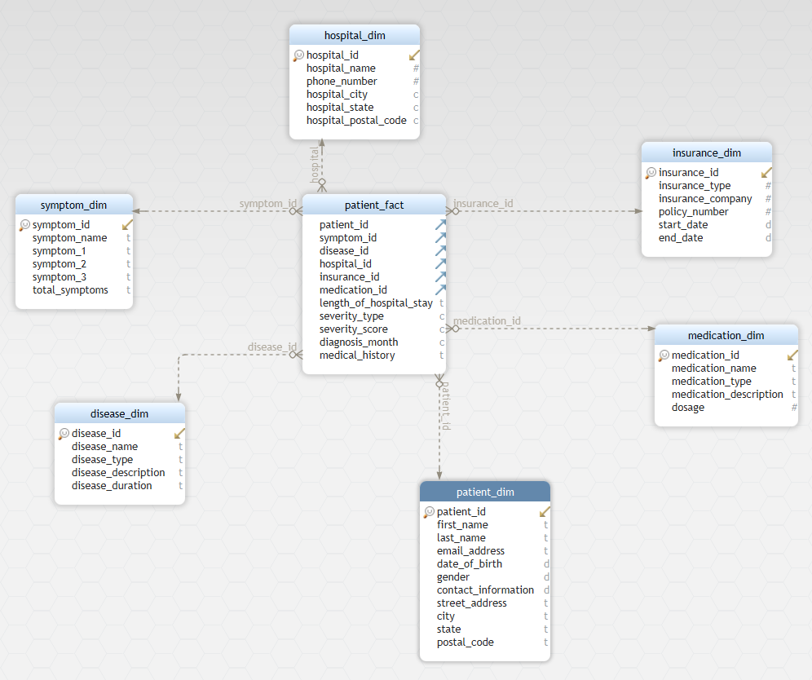
Dimensional Model – Star Schema
The model has 1 fact & 6-dimension tables

Slide 13
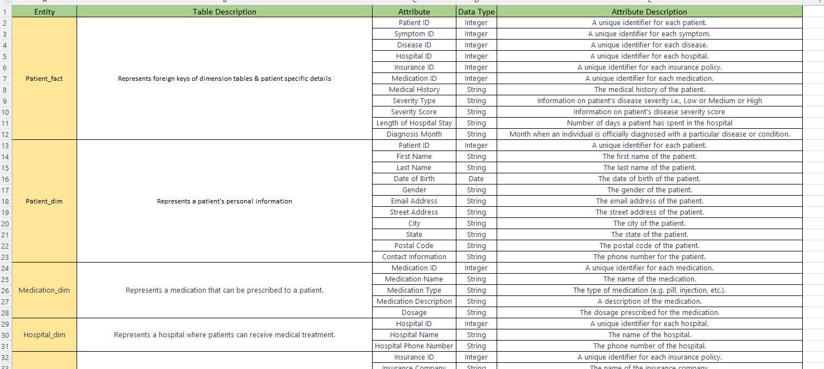
Dimensional Model - Data Dictionary

Slide 14
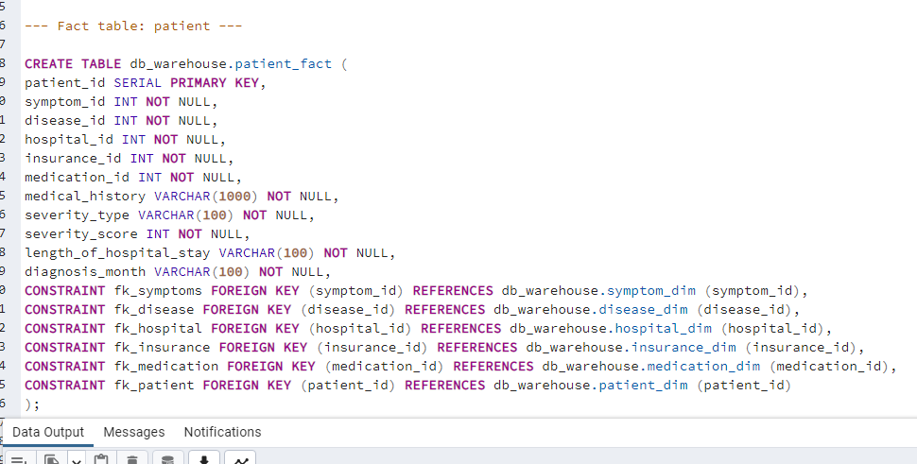
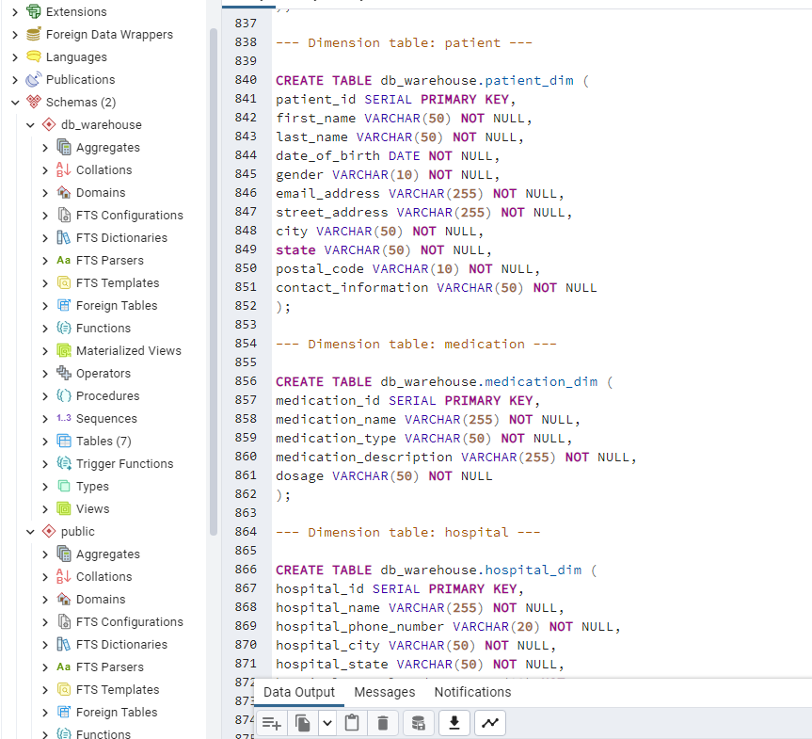
Dimensional Model – Create Tables

Slide 15
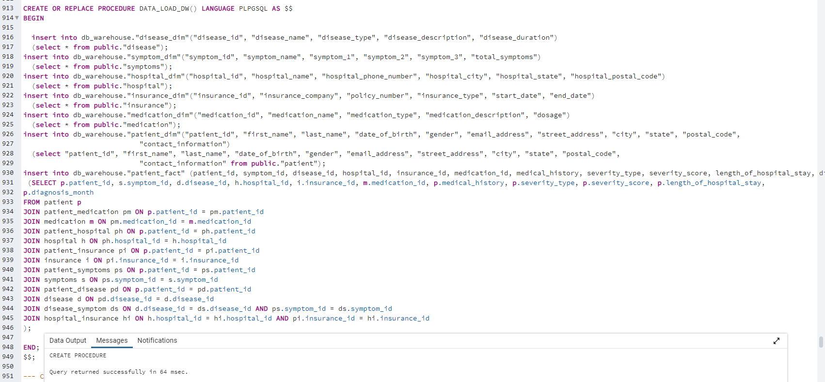
ELT Process to Load Data
Created a procedure with the name ‘DATA_LOAD_DW
Used ‘Joins’ to join the tables of OLTP model

Slide 16
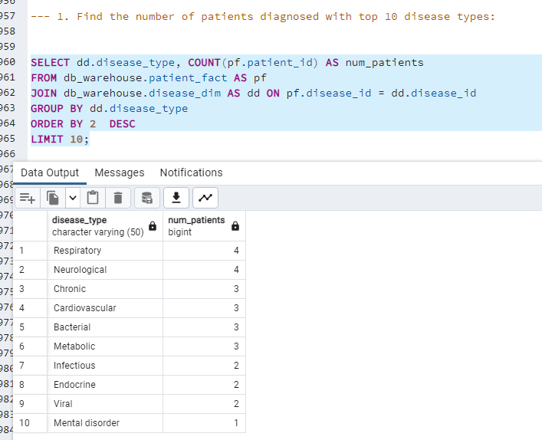
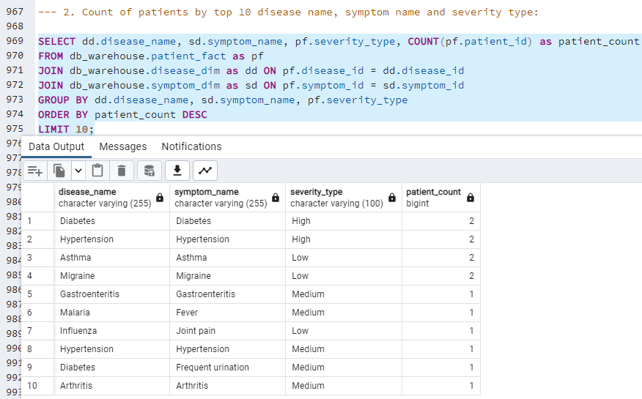
Analytical Queries

Slide 17
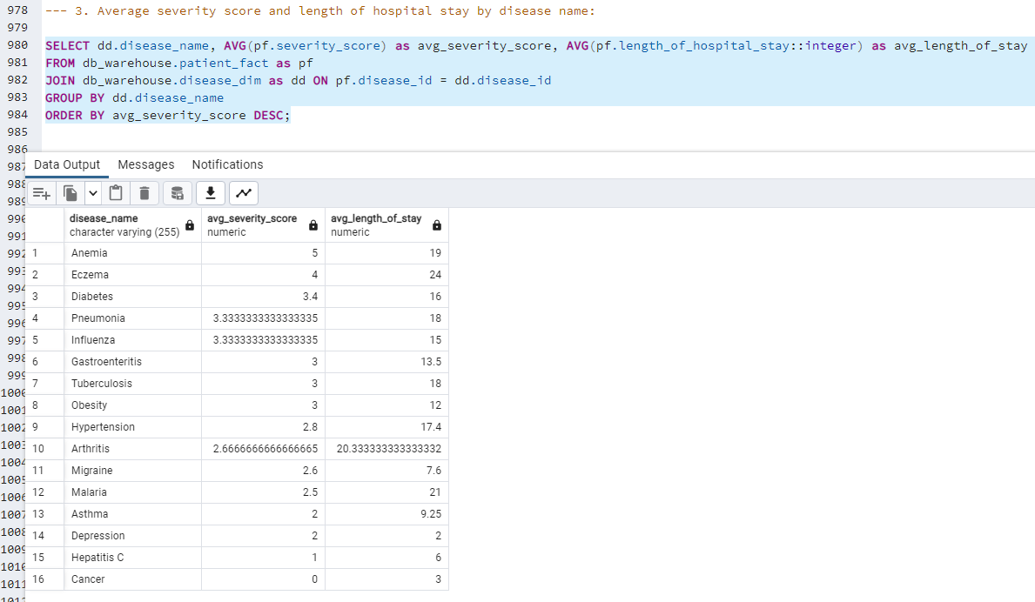
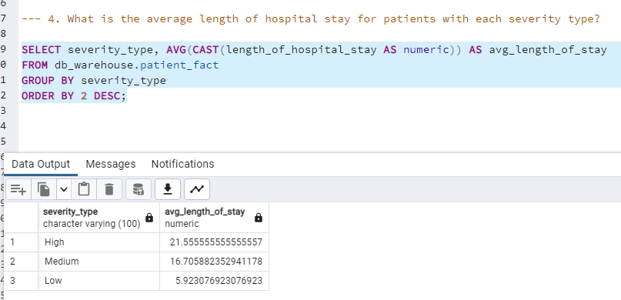
Analytical Queries

Slide 18
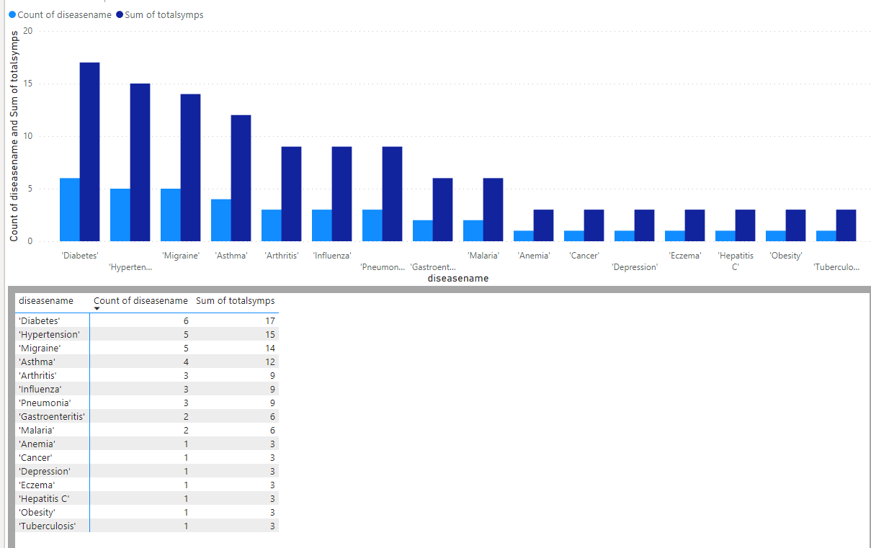
Visualization using Power BI
Clearly, patients with Diabetes are more than other diseases including high number of symptoms in total
Second most affected disease is Hypertension followed by Migraine

Slide 19
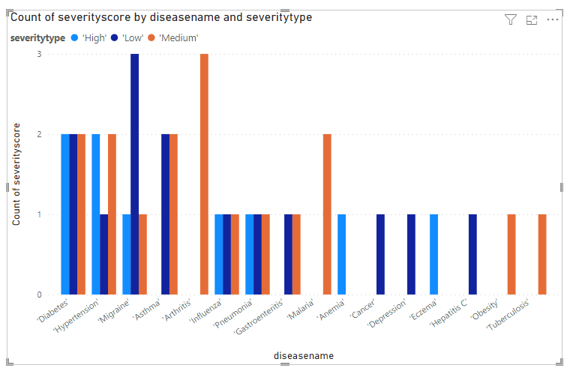
Visualization using Power BI
Patients with migraine usually tend to have low severity
Meanwhile, patients with Arthritis tend to have medium severity
Patients with diabetes fall under all types of severity

Slide 20
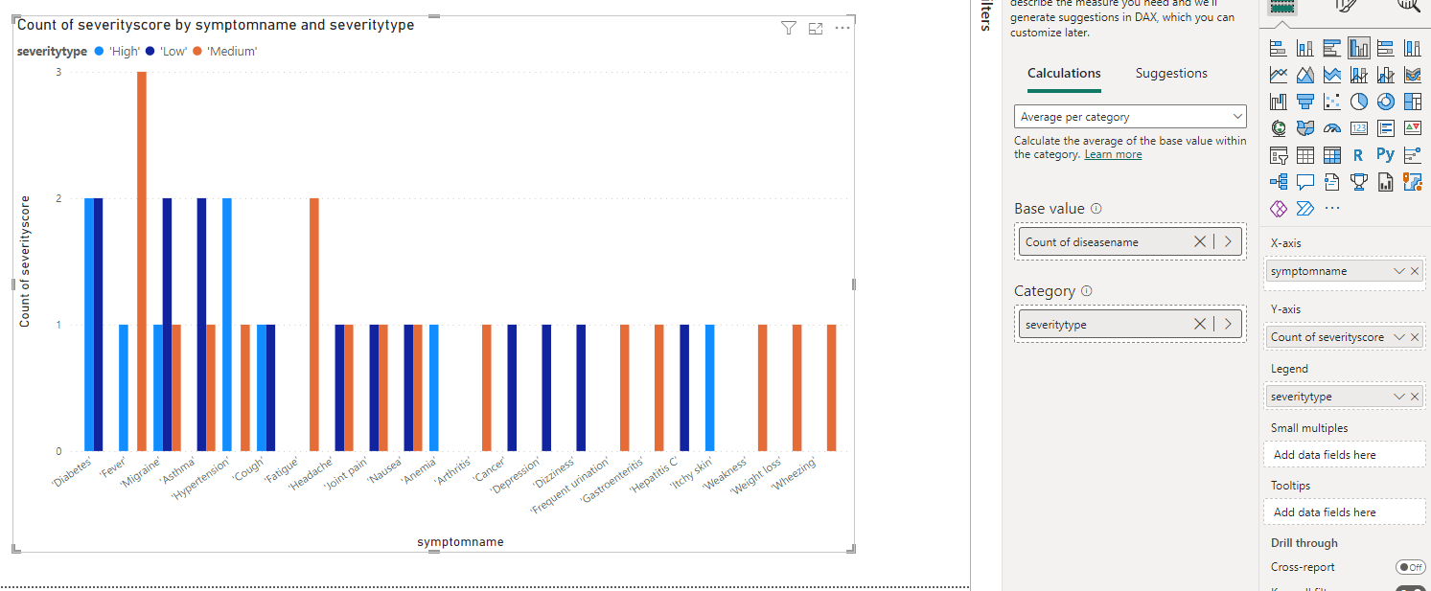
Visualization using Power BI
The symptoms for diabetes, fever, migraine & Asthma compared to others have high count of severity score i.e., more patients who experience these symptoms

Slide 21
NO SQL Databases
In general, NoSQL databases are flexible and schema-less, allowing for easy scalability and handling of unstructured or semi-structured data.
In the disease model, the structure of NoSQL would be represented differently.. Here’s how:
MongoDB:
The ‘patient_fact’ table can be stored as a collection in MongoDB, with each document representing a patient's record.
The attributes of it can be stored as fields within the document.
On the other hand, the dimension tables can be stored as separate collections in MongoDB. Each document within the dimension collections represents a unique entity and contains the corresponding attributes.
We can use embedded documents or references within the fact and dimension collections to establish relationships between documents
Neo4j:
In Neo4j, the star schema can be represented using nodes and relationships.
Each dimension table can be represented as separate node labels. Each node represents a unique entity and contains the corresponding attributes as properties.
The ‘patient_fact’ table can be represented as a node labeled "Patient" with its own unique properties i.e., the attributes. The relationships between the "Patient" node and the dimension nodes can be defined using relationships.

Slide 22
AWS Architecture
Amazon S3
Amazon Glue
AWS Data Pipeline
Application
AWS Lambda Functions
AWS RDS (PostgrRDSeSQL)
Amazon DynamoDB
AWS Redshift
Amazon Kinesis Data Streams
Amazon ES (Elasticsearch)
Amazon Cloud Watch
The above Lambda architecture combines batch processing & real-time streaming to handle data ingestion, processing & querying.
Amazon RDS: To host relational databases, such as PostgreSQL to store structured data.
Amazon S3: Stores data such as – Raw data, processed data, backups etc.,
Amazon DynamoDB: For fast & scalable access to dimension tables.
Amazon Kinesis Data Streams: To ingest & process real-time data streams & also for analysis.
Amazon Glue: Used for data transformation, cataloging & ETL processes for analysis i.e., batch processing.
Amazon Redshift: A data warehousing service used for large-scale data analytics & business intelligence.
Amazon ES: A fully managed search & analytics engine for real-time data exploration & visualization.
AWS Data Pipeline: To schedule & automate data movement & transformation workflows.
Amazon Cloud Watch: Used for batch processing, also trigger Lambda functions periodically.

Slide 23
Advantages of Snowflake
Scalability: Handle large amount of data and users without performance degradation.
Multi-cluster Architecture: Parallel processing of queries across multiple compute clusters helps improve performance and faster query execution, especially for complex analytical queries involving large datasets.
Separation of Compute and Storage: Snowflake decouples compute and storage, to scale each independently. This separation eliminates the need to provision and manage compute resources, resulting in more efficient resource utilization and cost optimization.
Zero-Copy Cloning: Creates near-instant clones of entire data sets without physically duplicating the data. This enables efficient data sharing, testing, and development processes without incurring additional storage costs.
Data Sharing: This helps to securely share data across different Snowflake accounts or with external organizations. This feature simplifies data collaboration and eliminates the need for data movement or replication.
Time Travel and Data Versioning: Snowflake has the ability to access and query historical data as it existed at different points in time. This feature provides easy data versioning and auditing capabilities without the need for complex data backup and restore processes.
Performance Optimization: Snowflake's query optimizer automatically analyzes query patterns and optimizes query execution plans. It leverages advanced techniques such as dynamic data pruning and automatic data clustering to optimize performance and minimize data movement.
Data Security: Snowflake provides robust data security features, including encryption at rest and in transit, role-based access controls, and granular data permissions. It ensures data privacy and compliance with regulatory requirements.

Slide 24
Any Questions

Slide 25
Thank You

